Slide 1
Facial Emotion Recognition
Project 3: Group 6
Mengyao He, Yuwei Tong, Yiqi Lei, Jiaqi Yuan, Qinzhe Hu

Slide 2
Table of Contents
Introduction
Model Selection & Evaluation
Baseline Model
Advanced Model
Feature Selection
Summary

Slide 3
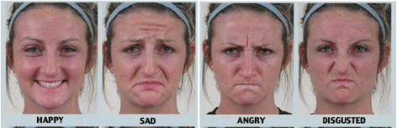

Introduction
Simple emotion:
Happy, sad, angry, disgusted, ...
Compound emotion:
Happily surprised, angrily surprised, sadly disgusted, ...

Slide 4
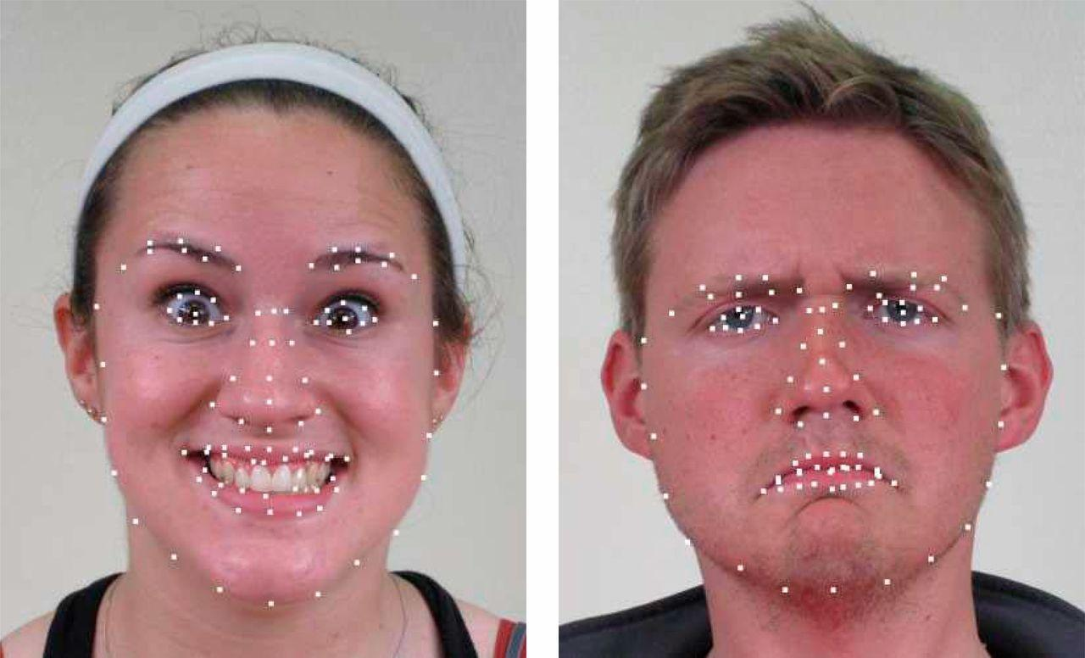
Introduction
Input data: 6006 features extracted from 78 fiducial points
3003 horizontal distances and 3003 vertical distances

Slide 5
Baseline Model - Gradient Boosting Machine (GBM)
Parameters: n.trees=60, shrinkage=0.15, others=default
Accuracy: 73.7%
AUC: 74.6%
Training time: 28.958s
Testing time: 0.338s

Slide 6
Models We Tried
Linear discriminant analysis (LDA)
Support Vector Machine (SVM)
Random Forest (RF)
Neural Network (NN)
Naive Bayes
XGBoost

Slide 7
Summary of Performance
Model Name | Accuracy | AUC | Training Time | Testing Time
GBM - Baseline | 73.7% | 74.6% | 28.958s | 0.338s
Neural Network (oversample) | 66.7% | 84.4% | 34.1s | 331ms
LDA (with PCA) | 82.7% | 61.2% | 0.090s | 0.346s
Naive Bayes | 80.0% | 62.8% | 0.13s | 0.12s
SVM | 79.5% | 65.5% | 132.069s | 8.947s
Random Forest | 80.3% | 69.27% | 940.659s | 1.159s
XGBoost - Advanced | 86.8% | 70.1% | 212.727s | 0.129s

Slide 8
Advanced Model - XGBoost
Parameters: eta=0.05, colsample_bytree=0.2, max_depth=6, min_child_weight=1, nrounds=300
Accuracy: 86.8%
AUC: 70.1%
Training time: 212.727s
Testing time: 0.129s

Slide 9
Feature Selection
PCA
threshold = 0.95
65 features
Forward Stepwise Selection
219 features
Lasso
117 features

Slide 10
Performance with Selected Features
Model Name | Accuracy | AUC | Training Time | Testing Time
XGBoost | 86.8% | 70.1% | 212.727s | 0.129s
XGBoost (with PCA) | 82.7% | 60.1% | 5.988s | 0.022s
XGBoost (with forward) | 82.8% | 63.7% | 19.705s | 0.031s
XGBoost (with lasso) | 80.8% | 51.3% | 5.472s | 0.027s
Random Forest | 80.3% | 69.27% | 940.659s | 1.159s
Random Forest (with PCA) | 81.8% | 78.4% | 19.263s | 0.076s
Random Forest (with forward) | 74.2% | 53.9% | 112.774s | 0.085s
Random Forest (with lasso) | 73.3% | 54.56% | 44.972s | 0.066s

Slide 11
Summary
Our Final Choice:
Model: XGBoost (eta=0.05, colsample_bytree=0.2, max_depth=6, min_child_weight=1, nrounds=300)
Input data: 6006 features
Result: accuracy=86.8%, AUC=70.1%, training time=212.727s, testing time=0.129s
Computer configuration: system: macOS Mojave version 10.14.6 | processor: 2.7 GHz Intel Core i5 | memory: 8 GB 1867 MHz DDR3

Slide 12
Reference
Github Link: https://github.com/TZstatsADS/Fall2020-Project3-group6

